Slide 1

Helena
RockSat-X: Hephaestus Midterm Project Update
Oregon State University
May 15th, 2017
Group 26: Helena Bales, Amber Horvath, Michael Humphrey
‹#›

Slide 2
1.0 Expo Pitch
Helena

Slide 3
Introduction
Helena
RockSat-X: Hephaestus

Slide 4
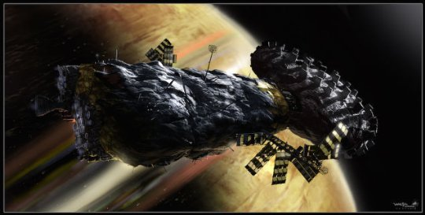
Story of Our Project
Michael

Slide 5
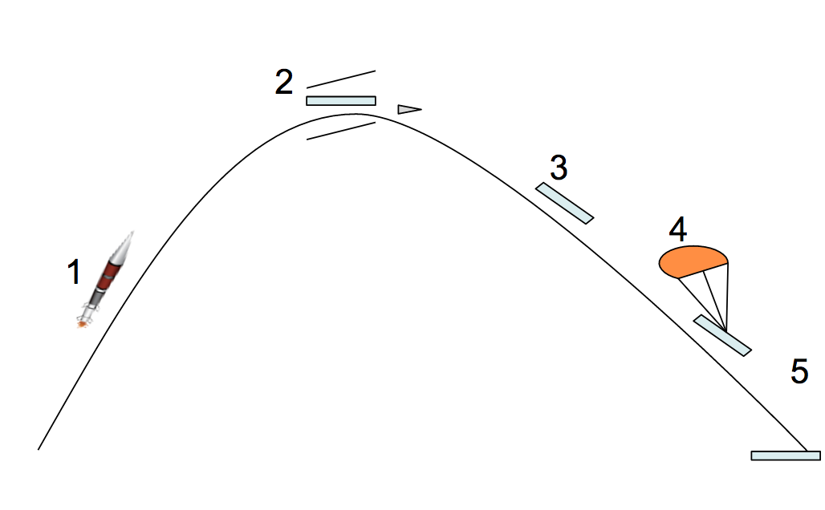
Mission Timeline
Helena
Launch
Apogee
Record video of action
Case extension
Arm extension
Arm rotates and touches targets on outside of rocket hull
Record touches with sensor
Case and Arm retract
Descent
Chute deploy
Landing
Payloads recovered

Slide 6
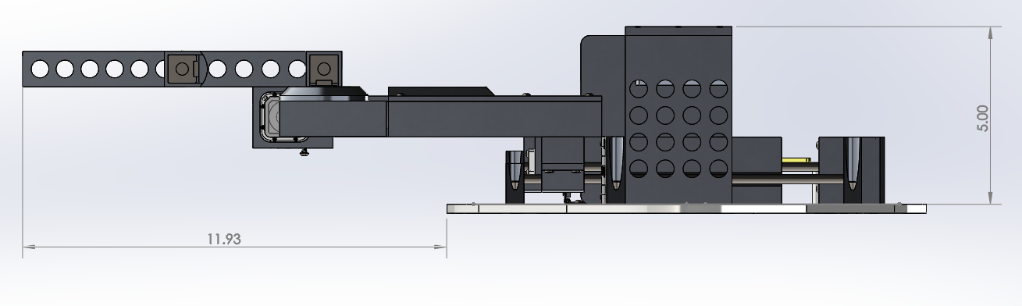
Technical Context
Helena and Amber

Slide 7
Technical Detail
Michael, Helena and Amber

Slide 8


Funding & Future Work
Helena
https://www.gofundme.com/osu-rocksatx-travel

Slide 9
2.0 Code Walkthrough

Slide 10
3.0 Software Overview
Amber

Slide 11
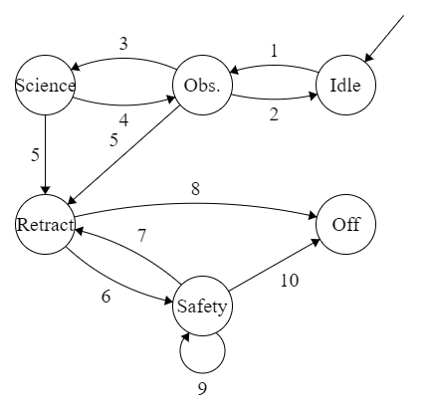
Software Design Overview - Modes of Operation
Amber
State diagram detailing the high-level transition between states
State Transition Key
Experiment begins. Payload is on, camera is powered on. Proceeds to Observation.
Camera is not on; return to Idle to recover.
Camera sweep has been performed and payload has been deployed. Arm is deployed. Proceed to Science.
Arm or payload fails to deploy or becomes stuck; return to Observation to recover.
Experiment has timed out. Proceed to Retract to
prepare for descent
Arm or payload fails to retract correctly or camera
fails to power off; proceed to Safety to recover.
Excess transition to be removed.
Arm is retracted, payload is retracted, camera is
powered off, OBC is powered off. Proceed to off
mode; Payload ready for descent.
Attempt to return arm to default position, attempt to
retract payload, and attempt to power off camera
and OBC until successful.
See 8.

Slide 12
Software Design Overview - Flow Diagram
Amber
Flowchart detailing our mode of operations during the flight

Slide 13
Software Design Details - Configuration Space
Helena Bales
The Configuration Space is in ℝ⁴.
It represents every possible configuration of the arm’s motors.
Areas in the configuration space can be mapped to a single point in real space.
A single point in the C-Space represents a valid configuration of the payload’s motors.
C-Space in ℝ⁴
Real space in ℝ³
forward kinematics,
easy to calculate
inverse kinematics,
hard to calculate

Slide 14
Software Design Details - Gathering C-Space Data
Helena Bales
Every valid configuration of the payload’s motors must be mapped in the C-Space.
Set Up:
Line the payload surfaces with foam board to create a buffer of forbidden space around the hardware
Attach the three back-driveable motors to the arm joints
Wire the motors to the Arduino UNO
Receive the theta values from the UNO to the computer
Method:
Run the motors through every valid configuration
Copy the values from the Arduino Serial interface to a file to save the values because that’s the easiest way to do it
Parse the data and fill out the 4D array of the CSpace
Code:
The code can be found at: https://github.com/balesh2/SeniorDesign/blob/master/code/CSpace/CSpace_Mapping/CSpace_Mapping.ino

Slide 15
Software Design Details - Creating the C-Space
Helena Bales
The parser is responsible for reading in all the valid configurations of motors that will make up the C-Space, then converting them into a 4D array of motor positions.
Input: ./test1/data1 - a file of valid motor configurations
Output: ./cspace - a file containing the C-Space as a single line of boolean data representing a 37x37x37x37 array.
Method:
Read in a valid motor configuration by reading and saving four lines then discarding one to get four motor values and a semicolon
Convert the values to positive degree form (i.e. -10 to 350)
Convert the values from degrees to array indices (floor of val/10)
Mark that location in the C-Space as valid
Code:
The code can be found at:
https://github.com/balesh2/SeniorDesign/blob/master/code/CSpace/parser.cpp

Slide 16
Software Design Details - Pathing and Automation
Helena Bales
Pathing and automation is the section of the code responsible for creating collision-free paths for the arm and moving the arm along the generated paths.
Input: IR4 Configuration Space, list of target points.
Output: Moving the arm from one target point to the next without collisions.
target points
Convert target points from real space to IR4 C-Space
target points in C-Space
C-Space
Dijkstra’s Algorithm from current position to target
path
Move arm along path
(on orbit)

Slide 17
Software Design Details - Converting Target Points
Helena Bales
The target positions for the arm must be converted from their original format representing real space into a list of corresponding points in the C-Space.
Input: List of target points in real space
Output: List of( list of target points in configuration space in ℝ⁴)
Code: https://github.com/balesh2/tree/master/code/CSpace/convert.cpp
Pseudocode:
For each point in list of target points {
a = first element in list of targets (remove from list)
create list of 4D points l[]
inverse kinematics on a, store each possibility in l[]
}

Slide 18

Software Design Details - Dijkstra’s Algorithm
Helena Bales
The path of the arm shall be generated using the Dijkstra’s pathfinding algorithm within an ℝ⁴ configuration space.
Input: Starting position <𝛳₁, 𝛳₂, 𝛳₃, 𝛳₄>, possible ending positions in ℝ⁴, configuration space in ℝ⁴.
Output: Path from starting position to best ending position with no collisions.
A* Progress Animation [1]
Pseudocode: [2]
function A*(start, goal) {
closedSet := {} //set of nodes already evaluated
openSet := {start} //set of known nodes
cameFrom := the empty map //map of previous steps
gScore := map with default value of Infinity //cost from start to current
gScore[start] := 0 //cost of going from start to start
fScore := map with default value of Infinity //cost from start to end
fScore[start] := heuristic_cost_estimate(start, goal) //start cost is heuristic

Slide 19
Software Design Details - Dijkstra’s Algorithm
Helena Bales
Pseudocode: (continued) [2]
while openSet is not empty current := the node in openSet having the lowest fScore[] value if current = goal return reconstruct_path(cameFrom, current) openSet.Remove(current) closedSet.Add(current) for each neighbor of current if neighbor in closedSet continue // Ignore the neighbor which is already evaluated.
tentative_gScore := gScore[current] + dist_between(current, neighbor) //start to current if neighbor not in openSet // Discover a new node openSet.Add(neighbor) else if tentative_gScore >= gScore[neighbor] continue // This is not a better path
//record the new best path
cameFrom[neighbor] := current gScore[neighbor] := tentative_gScore fScore[neighbor] := gScore[neighbor] + heuristic_cost_estimate(neighbor, goal)
return failure;

Slide 20
Software Design Details - Arm Motion
Helena Bales
The motion of the arm shall be controlled by the On Board Computer (OBC) interfacing with the motor drivers.
The path of the arm shall be generated on orbit using the A* pathfinding algorithm within an ℝ⁴ configuration space (C-Space).
Input: Path generated by A* through the C-Space
Output: Motor control commands
Code: https://github.com/balesh2/tree/master/code/Hephaestus/Hephaestus/science.c
Pseudocode:
void function moveArm(path) {
current = first node in path
remove first node from path
for p in path {
//move from current to p
moveStep(current, p);
remove p from path
}
}
void function moveStep(current, p) {
//let current=<𝛳₁, 𝛳₂, 𝛳₃, 𝛳₄>
//let p=<𝛳₅, 𝛳₆, 𝛳₇, 𝛳₈>
delta1 = 𝛳₅ - 𝛳₁
delta2 = 𝛳₆ - 𝛳₂
delta3 = 𝛳₇ - 𝛳₃
delta4 = 𝛳₈ - 𝛳₄
move motor 1 delta1 steps
move motor 2 delta2 steps
move motor 3 delta3 steps
move motor 4 delta4 steps
}

Slide 21
Software Design Details - Arm Retraction
Amber Horvath
In the case of the arm getting caught in a bad state or the experiment timing out, we shall retract the arm
If the arm is stuck in a bad state, we will detect this by determining if the arm is in the calibrated home position after moving to a target and back
If arm is not calibrated, then retract arm
We also implemented an interrupt that is triggered when the timer event line goes high, signaling the end of the experiment
If the timer event line goes high, then retract arm
To retract the arm
Disable each motor except the one attached to the base of the payload
Change direction of the motor’s rotation to go counter-clockwise
Have motors step to bring the arm in

Slide 22
Software Design Details - Touch Sensor
Amber Horvath
Within the body of the payload, two touch sensors will be placed at predetermined locations
The arm shall make contact with the touch sensor and press it
Upon being pressed, the touch sensor will go high and send a signal over telemetry
The result of this touch will also be recorded locally on EEPROM
The arm will then recalibrate before moving to the next sensor
If no sensors remain, the arm will retract and await shutdown

Slide 23
Software Design Details - Data Storage
Amber Horvath
There shall be a stand-alone software program to record analog data and log data to EEPROM
The software shall be written in AVR-C
The software shall succeed in logging data in pre-formatted strings

Slide 24
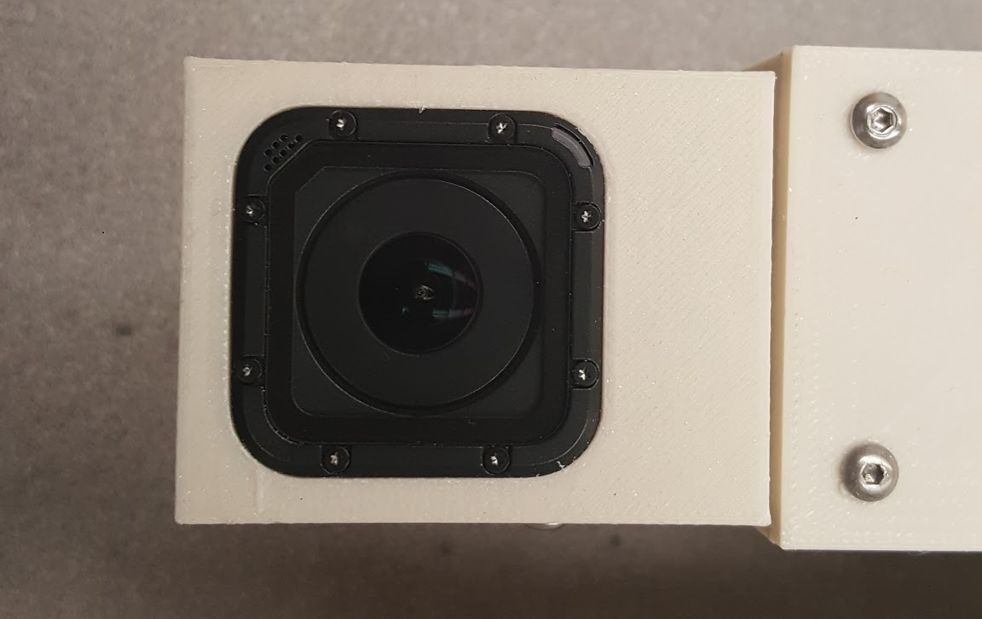
Software Design Details - Video Camera
Michael
One GoPro Hero camera will be mounted to the payload.
The camera shall be controlled by a single motor adjusting the rotation of the camera.
The camera shall record video to its own SD card.
The camera shall be powered on and off at the appropriate times by hardware triggers.
This will be handled by the Electronics team.

Slide 25
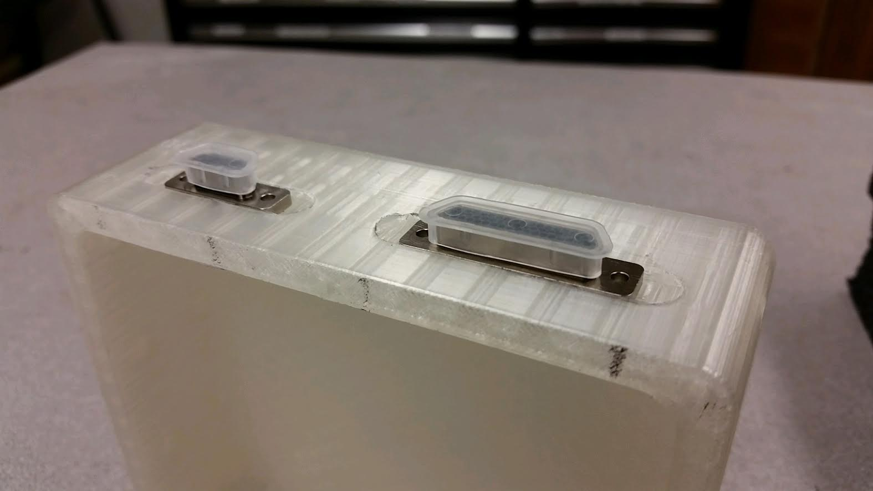
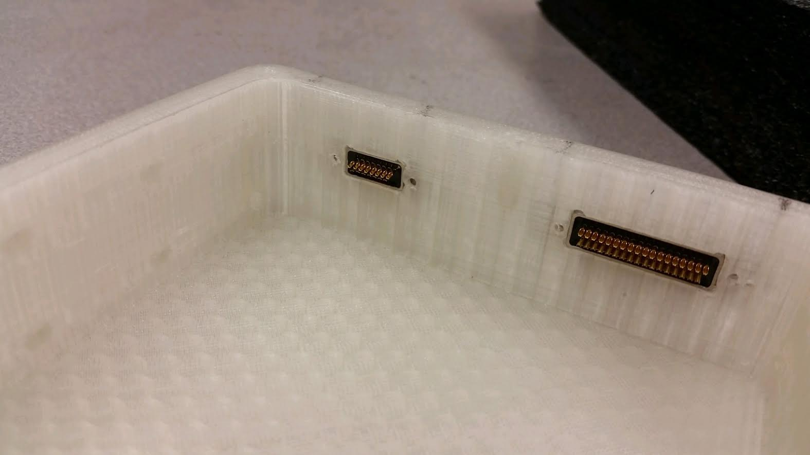
Software Design Details - Telemetry
Michael
The payload software shall report telemetry codes via 4 parallel lines.
There shall be 16 4-character codes, representing various states and checkpoints the program reaches.
Examples:
State transition
Touch sensor activated
Calibration

Slide 26
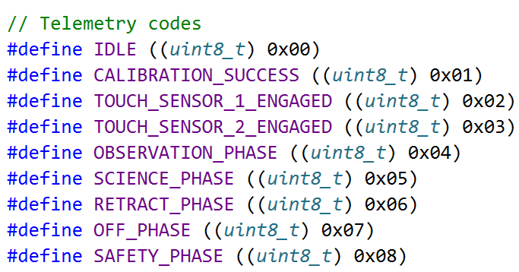
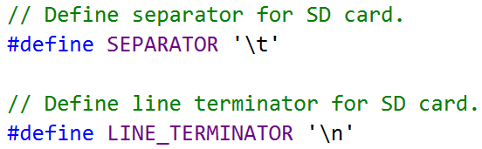
Software Design Details - Telemetry
Michael
The payload software shall save a detailed log of operations to an on-board EEPROM memory.
The log should include
Time in tenths of seconds since power on
Description of event

Slide 27
Software Design Details - Data Visualization
Michael
There shall be a stand-alone software program to read and display the telemetry data stored in the eeprom memory.
The software shall be written in Python, because of the team’s familiarity with the language as well as its ease of use and readability.
The matplotlib Python library shall be used to generate graphs and charts of the data obtained.
The Tkinter Python library shall be used to create the Graphical User Interface (GUI)
There shall be graphs representing temperature data and a timeline of significant events, as well a textual representation of the log file.

Slide 28
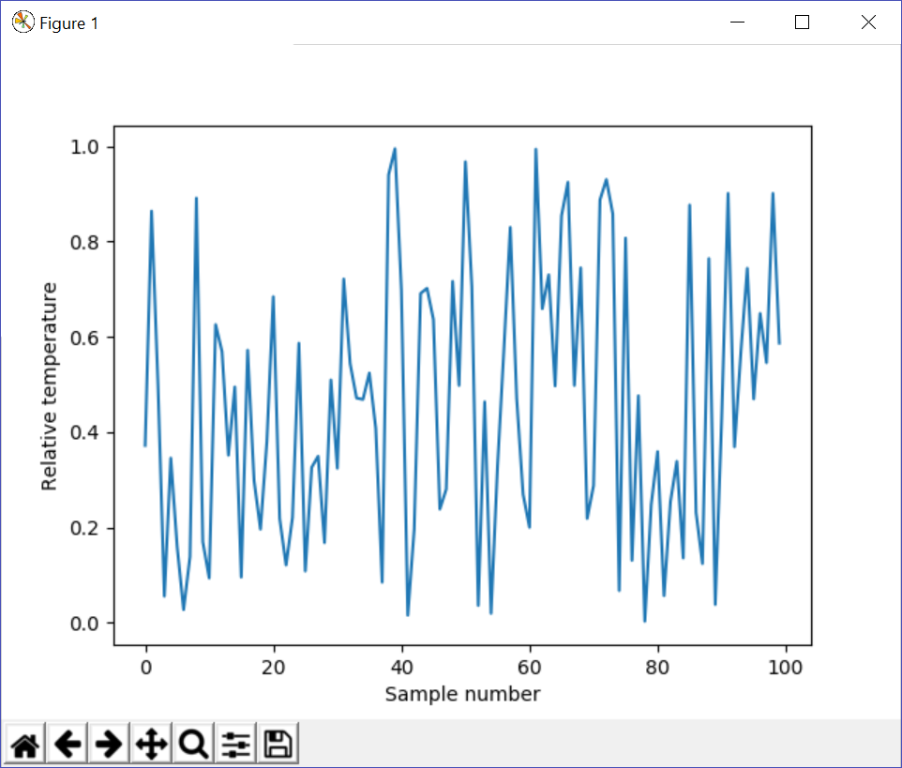
Software Design Details - Data Visualization
Michael

Slide 29
4.0 Progress Update
Helena

Slide 30
Update on Configuration Space Creation
Helena
The Configuration Space has been created. The process for creating the configuration space has been followed, and the data has been used to create the CSpace.
Blocks:
None.
Remaining Work:
None.

Slide 31
Update on Pathfinding
Helena
The pseudocode for the pathfinding algorithm has been written. The code for pathfinding has not yet been written. Dijkstra’s algorithm will now be used instead of A*.
Blocks:
None.
Remaining Work:
Dijstra’s algorithm must be implemented on the OBC through the C-Space.

Slide 32
Update on Arm Movement
Helena
The motor control drivers have been written by the EE team. The code for executing a given path has been written.
Blocks:
The motors were received on February 20th, unblocking this step.
Remaining Work:
None

Slide 33
Update on Arm Retraction
Amber Horvath
The motor control drivers have been written by the EE team. The code to retract the arm has been written and implemented. The interrupt subroutine has been written that will call the retract function. Motors have been attached to the arm body.
Blocks
None
Remaining Work
None

Slide 34
Update on Touch Sensors
Amber Horvath
Code to determine whether a touch sensor has been depressed has been implemented. Logging of touch sensors being depressed has also been implemented. Locations on the payload to place the touch sensors have been chosen.
Blocks
None
Remaining Work:
The touch sensors must actually be placed on the body of the payload

Slide 35
Update on Data Storage
Amber Horvath
We moved our implementation efforts to EEPROM as the FatFS library we were attempting to use was too cumbersome to get fully functional. We have implemented the code to utilize EEPROM and log data to EEPROM within our implementation
Blocks
None
Remaining Work
None

Slide 36
Update on Video Camera
Michael
The GoPro Hero camera has been purchased and received. The Electronics team has disassembled the camera, and found ways to trigger video capture autonomously.
Blocks:
None
Remaining Work:
None.

Slide 37
Update on Telemetry
Michael
Half of the telemetry codes have been allocated. The remaining eight telemetry codes may be allocated for any purpose. API has been finally implemented. SD card code has been removed. Eeprom logging fully implemented.
Blocks:
None.
Remaining Work:
None.

Slide 38
Update on Data Visualization
Michael
Proof-of-concept application has been created with fake data and a graph has been generated. A testing framework has also been created to test this component.
This subsystem may be completed after the payload has been completed.
Blocks:
Waiting for format of telemetry data from NASA.
Remaining Work:
Create full user interface for application.

Slide 39
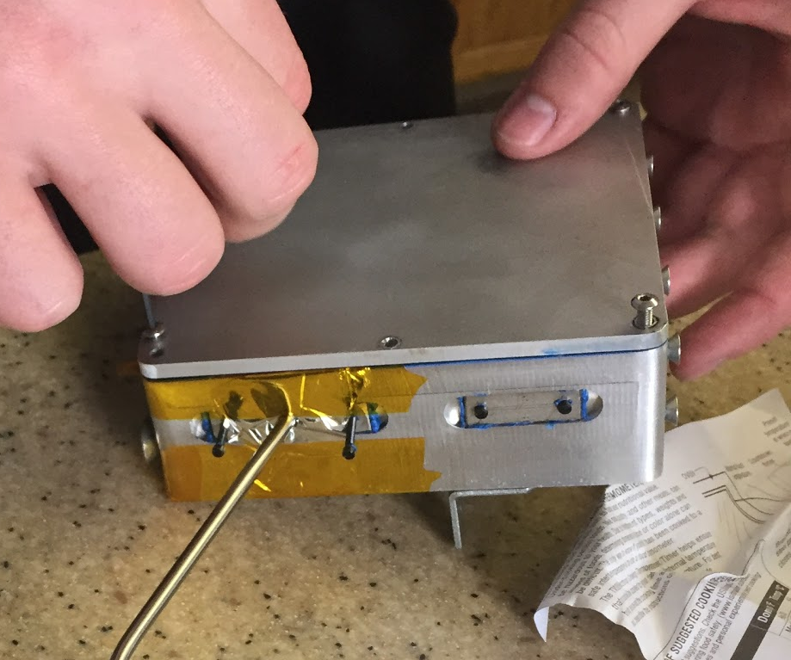
Update on Machined Hardware
Amber Horvath
The machining of the aluminium payload has been completed.
The parts have passed the following tests:
Water-proofing of electrical box
Preliminary vibration test
Heat test
Freezer test
Stress test
Above: Completed Electrical Box

Slide 40
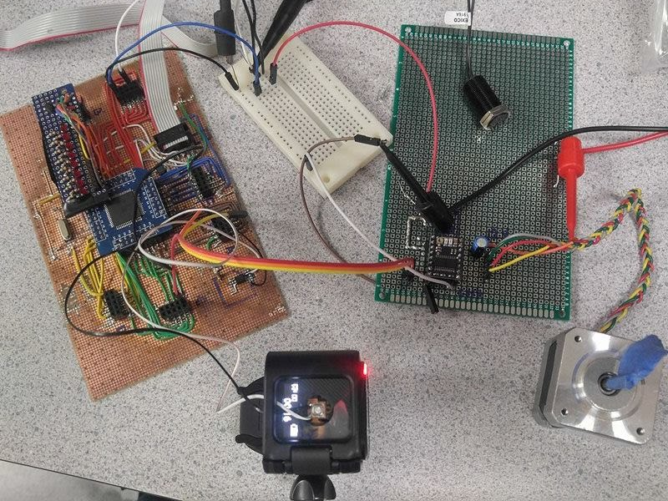
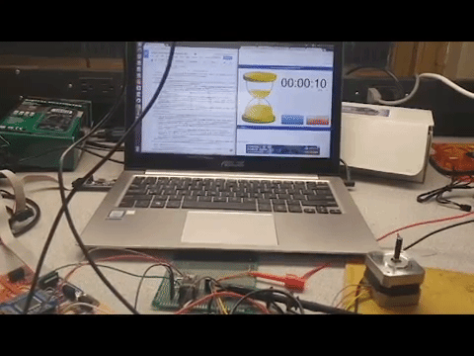
Update from Electrical Team
Amber Horvath
Quick Update:
ATmega128 can be programmed.
Motor control drivers have been programmed.
Voltage regulator has been completed then redesigned.
PCB has been printed

Slide 41
5.0 Project Hurdles
Amber Horvath

Slide 42
Blockers
Amber Horvath
Funding
Arm weight
Notes:
Our funding release was delayed, so we were unable to purchase supplies until later in the term. This lead to us not getting our motors until February 20th. Due to this delay, we have been unable to test the implementation of our drivers.
Due to the nature of our project, it is difficult to implement and test code without a working prototype of the arm.
The arm has been fully prototyped and manufactured but it cannot move due to being too heavy. This makes testing our implementation very difficult and time consuming as we must manually calculate the rotation and movement of the motors in order to determine whether our code is functioning as opposed to just seeing whether the arm moves and functions the way we expect it to.

Slide 43
Conclusion
Michael
See ya at Expo!

Slide 44
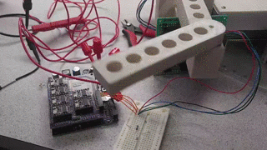
Conclusion
Michael

Slide 45
Citations
[1] S. Bhattacharya, A Star Progress Animation. 2011.
[2] "A* search algorithm", En.wikipedia.org, 2017. [Online]. Available: https://en.wikipedia.org/wiki/A*_search_algorithm#Pseudocode. [Accessed: 21- Feb- 2017].

